Slide 1
MORDM using Rhodium The lake problem workflow
Antonia Hadjimichael
INFEWS workshop
August 13, 2019
Notes:
Overarching Theme of Research – 5 min
Lake Problem work so far – 10 min
Red River work so far – 10 min
Papers/studies (<= 10 min)
Lake study
Policy diagnostic on Red River
Expand information in policies and explore robustness to climate change
Back-up slides anticipating questions

Slide 2
Disclaimer and additional info
This training is meant to guide you on the what and why of MORDM using the lake problem. There is a lot of material others have written which I will be reusing because there is no point in reinventing the wheel:
Julie’s GH repository for the system
Julie’s paper
Dave Hadka’s Rhodium example scripts (that I modified)
A lot of these slides have also been prepared by others (Julie Quinn, Jon Herman, Tori Ward, Dave Gold)
The scripts and data I’ll be referring to here can be downloaded from this repository

Slide 3
Learning outcomes of this training
Use Rhodium for:
Optimization to generate alternatives
Exploratory modeling for multiple states of the world
Assess the robustness of candidate solutions
Sensitivity analysis to identify key factors for failure
Highlight the importance of these steps in the context of MORDM
Demonstrate the value of Direct Policy Search (DPS)
Investigate the challenges posed by nonlinear tipping points

Slide 4
Many-Objective Robust Decision Making (MORDM)
Exploratory modeling framework
Investigate the response of alternative management plans to a wide range of deeply uncertain states of the world (SOWs)

Slide 5
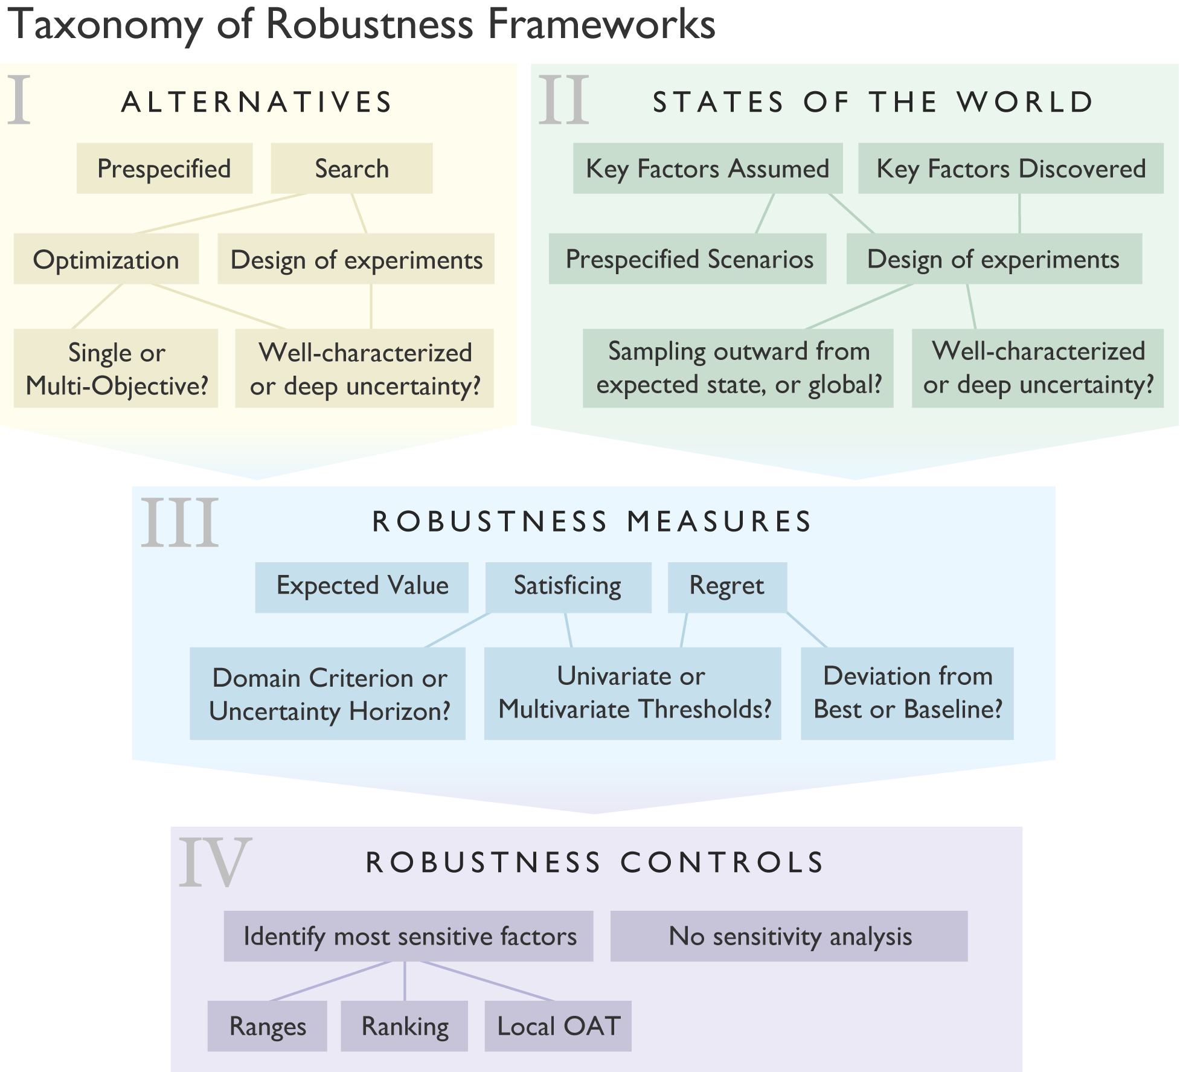
Taxonomy of robustness frameworks
Herman et al. (2015)
https://doi.org/10.1061/(ASCE)WR.1943-5452.0000509

Slide 6







Rhodium Robust Decision Making
Python library capable of:
Multi-objective Optimization
Exploratory Modeling
Scenario Discovery
Global Sensitivity Analysis
Dave Hadka,
Developer
Acts as the “glue” between your model and analysis codes
Connects to models in C, C++, Fortran, Excel, R, Python
Fortran

Slide 7
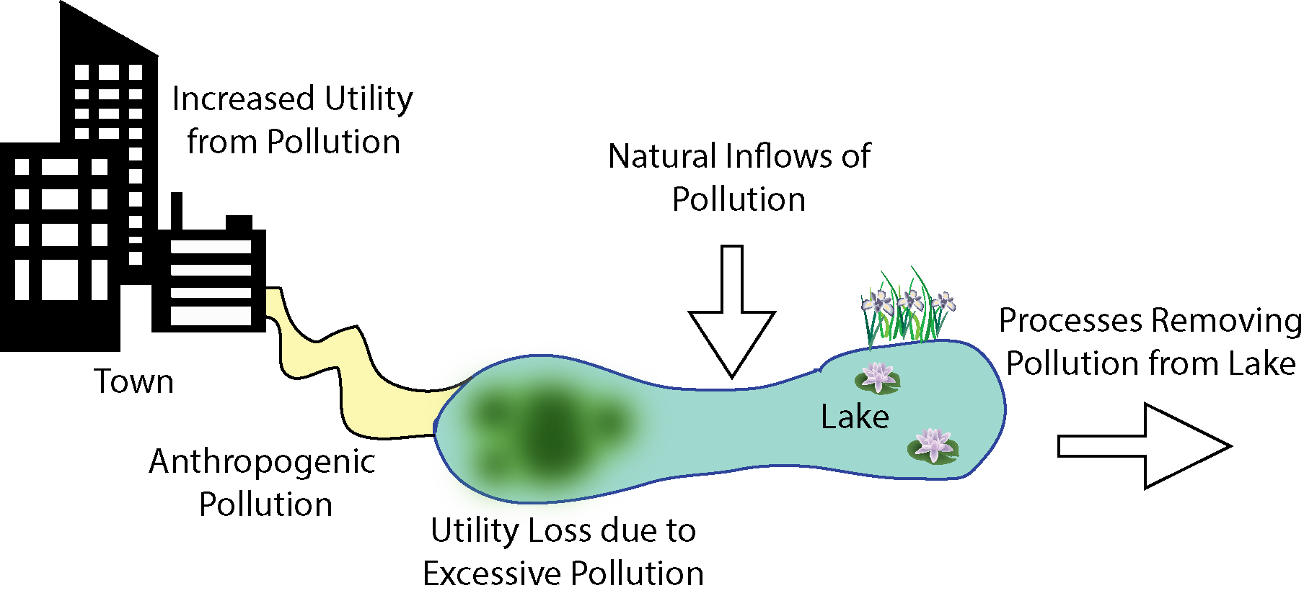
The Shallow Lake Problem
P Recycled in the Lake
Environmental and Economic Objectives are in Direct Conflict
Slide credit: Tori Ward
Notes:
Notes on Lake Problem choice: It is one of the most popular tipping point benchmark problems to emerge from environmental decision-making literature.
It has a rich conceptualization that allows for exploration of challenging management and mathematical traits with relatively modest computational demands.

Slide 8
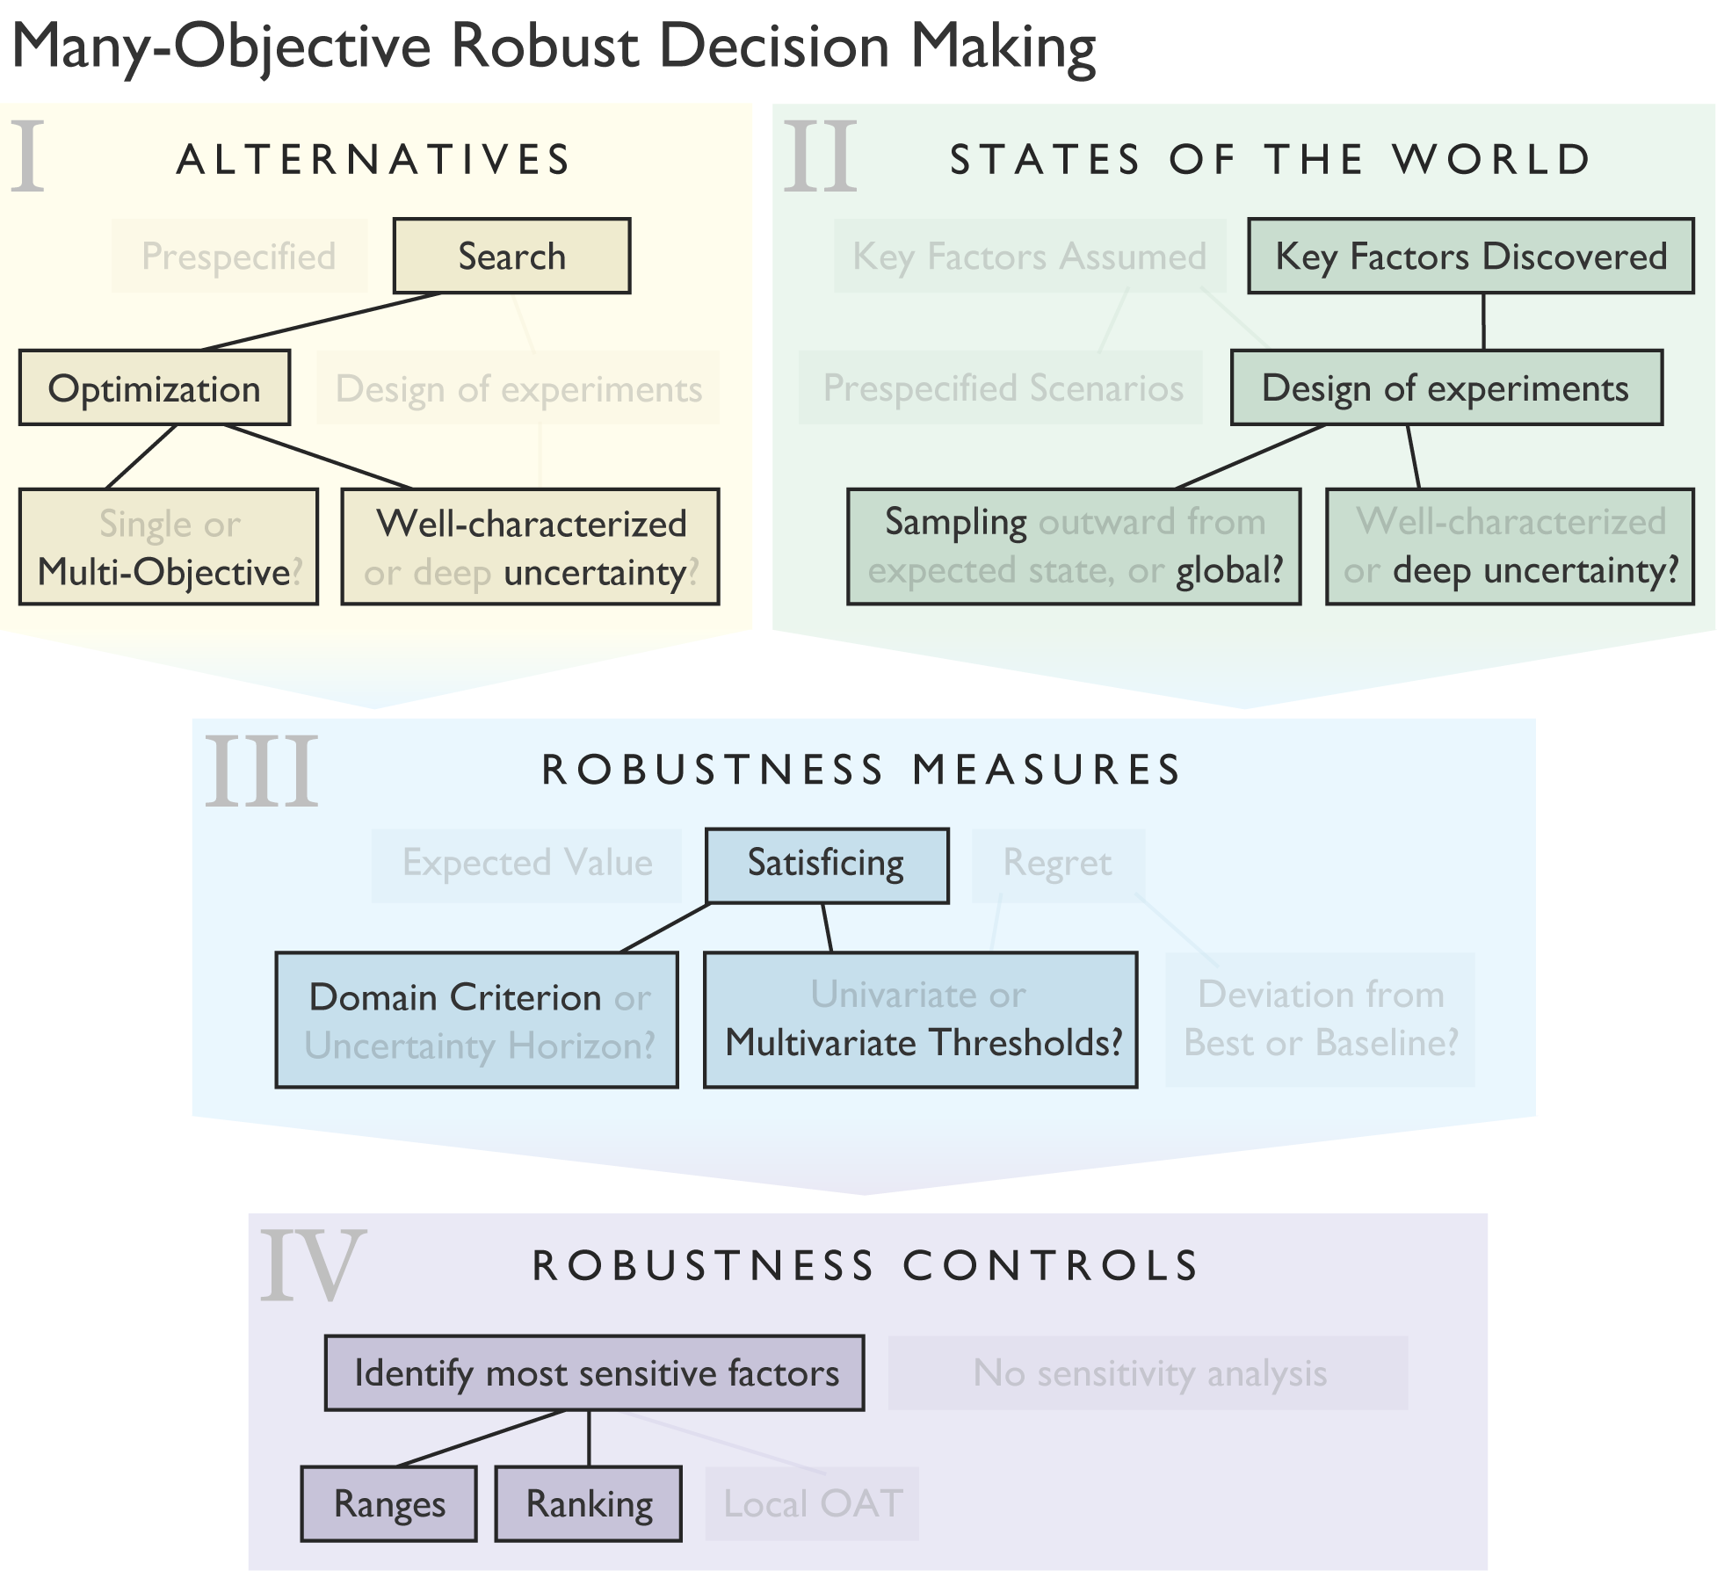
MORDM using Rhodium The lake problem workflow

Slide 9
MORDM using Rhodium The lake problem workflow
Difficult to identify effective policies:
High dimensional decision space for candidate actions (one action per timestep)
Weak system response to decisions at the end of the study period
Non-linear threshold
Use of Direct Policy Search (DPS):
Closed loop control
Map system states to decisions
Result in a policy, not a sequence of actions

Slide 10
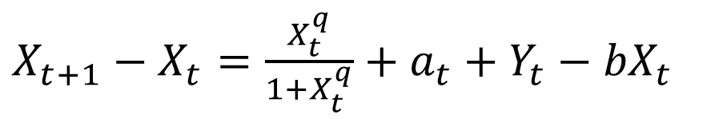
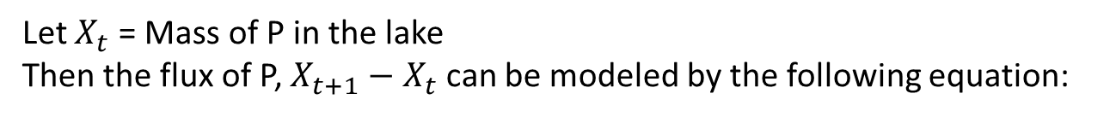
Model of lake dynamics
Let $X_{t}$ = Mass of P in the lake
Then the flux of P, $X_{t+1}−X_{t}$ can be modeled by the following equation:
$X_{t+1}−X_{t}=\frac{X_{t}^{q}}{1+X_{t}^{q}}+a_{t}+Y_{t}−{bX}_{t}$
10
Notes:
Discuss reversible, hysteretic, and irreversible lakes and mention that this study focused on irreversible lakes.

Slide 11
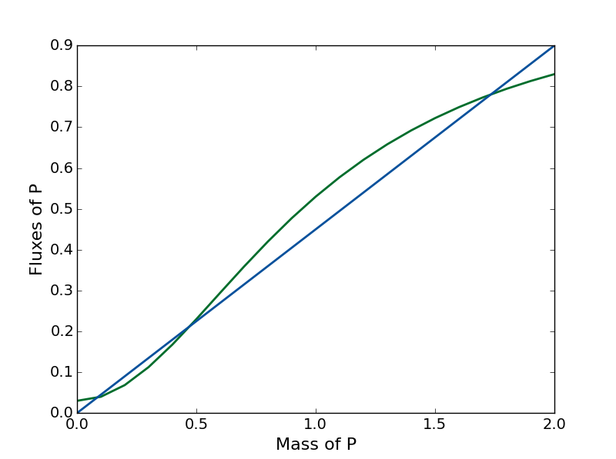
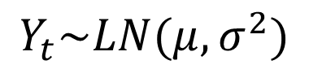
Model of lake dynamics
Fluxes of P
Recycled P
Anthropogenic P Inputs
Natural P Inputs
P Sinks
$X_{t+1}−X_{t}=\frac{X_{t}^{q}}{1+X_{t}^{q}}+a_{t}+Y_{t}−{bX}_{t}$
$$Y_{t}\sim LN(μ,σ^{2})$$
11
Notes:
Discuss reversible, hysteretic, and irreversible lakes and mention that this study focused on irreversible lakes.

Slide 12
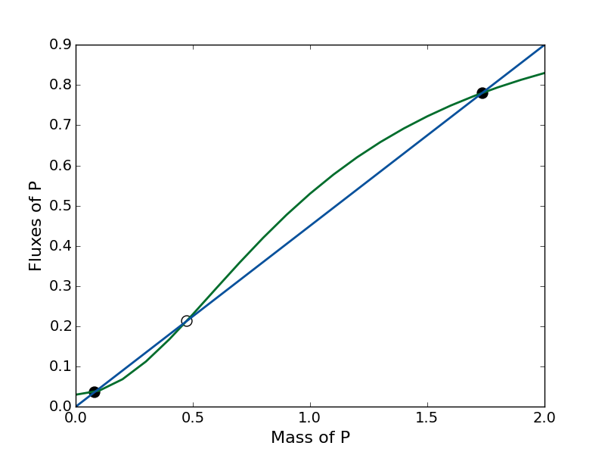
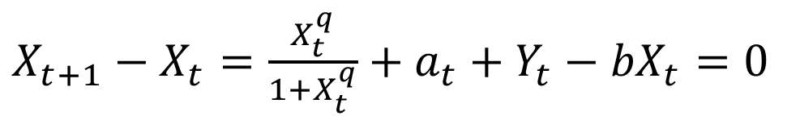
Model of lake dynamics
Fluxes of P
Inputs
Outputs
$X_{t+1}−X_{t}=\frac{X_{t}^{q}}{1+X_{t}^{q}}+a_{t}+Y_{t}−{bX}_{t}=0$
Equilibrium
12
Notes:
Discuss reversible, hysteretic, and irreversible lakes and mention that this study focused on irreversible lakes.

Slide 13
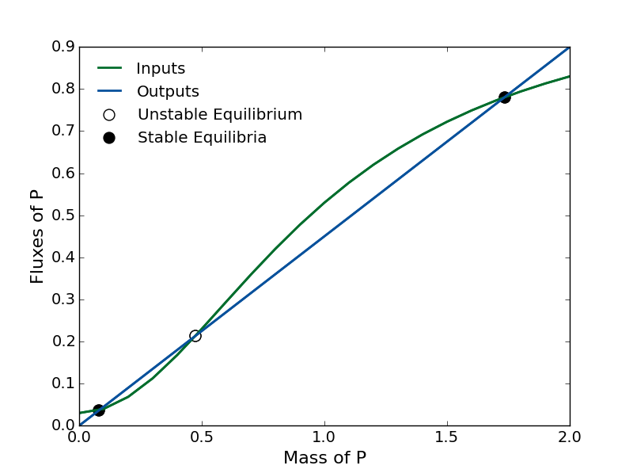
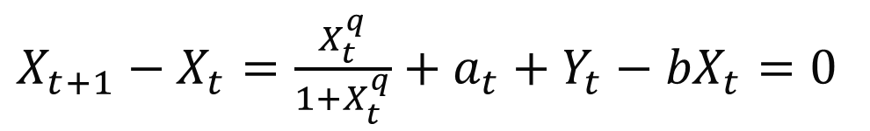
$X_{t+1}−X_{t}=\frac{X_{t}^{q}}{1+X_{t}^{q}}+a_{t}+Y_{t}−{bX}_{t}=0$

Slide 14
$X_{t+1}−X_{t}=\frac{X_{t}^{q}}{1+X_{t}^{q}}+a_{t}+Y_{t}−{bX}_{t}=0$
Direction of Attraction

Slide 15
$X_{t+1}−X_{t}=\frac{X_{t}^{q}}{1+X_{t}^{q}}+a_{t}+Y_{t}−{bX}_{t}=0$
Direction of Attraction
Unhealthy, Eutrophic Equilibrium
Healthy, Oligotrophic Equilibrium

Slide 16
$X_{t+1}−X_{t}=\frac{X_{t}^{q}}{1+X_{t}^{q}}+a_{t}+Y_{t}−{bX}_{t}=0$
Direction of Attraction
Unhealthy, Eutrophic Equilibrium
Tipping Point
Healthy, Oligotrophic Equilibrium

Slide 17
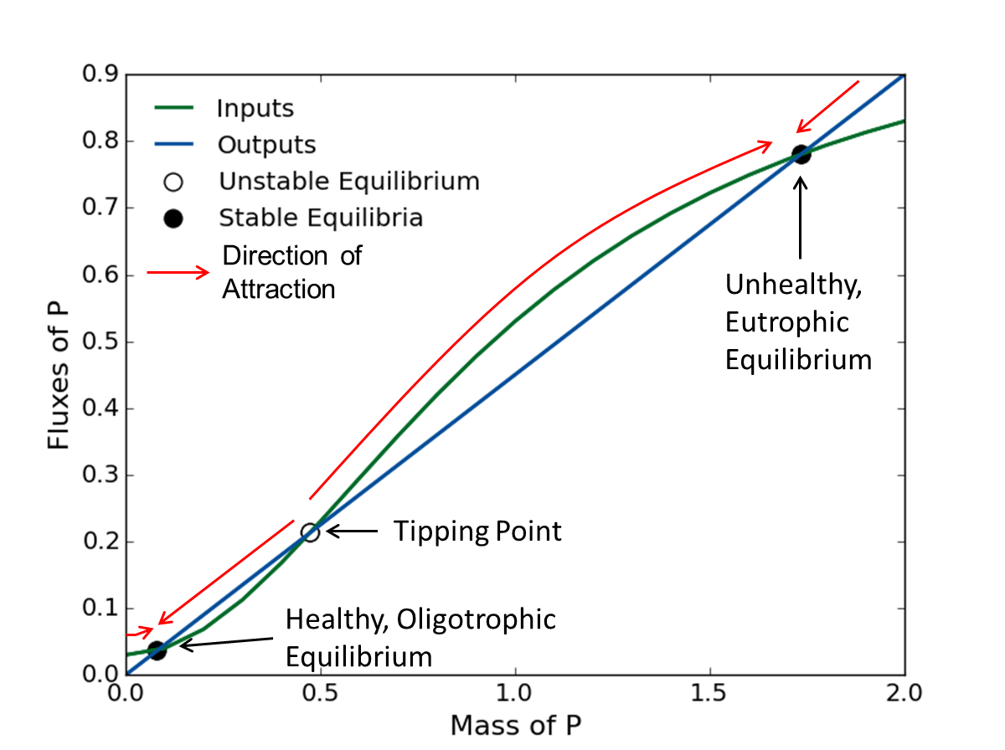
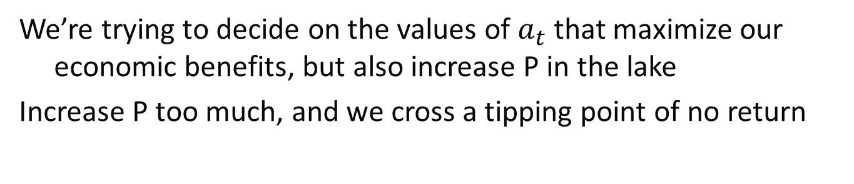
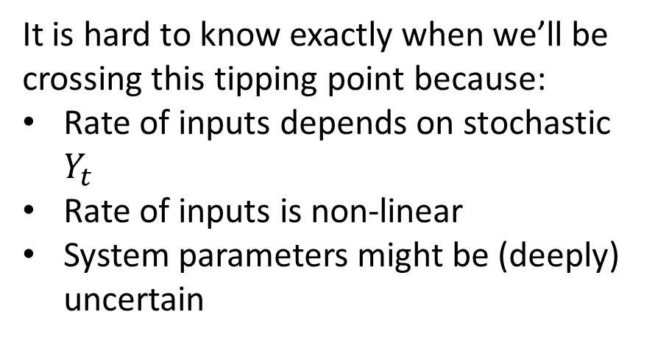
Why is this important?
We’re trying to decide on the values of $a_{t}$ that maximize our economic benefits, but also increase P in the lake
Increase P too much, and we cross a tipping point of no return
It is hard to know exactly when we’ll be crossing this tipping point because:
Rate of inputs depends on stochastic $Y_{t}$
Rate of inputs is non-linear
System parameters might be (deeply) uncertain

Slide 18





Multi-objective formulation of the Lake Problem
Objective 1:
Objective 2:
Maximize Expected Economic Benefits
Minimize Maximum P Concentration
Objective 3:
Objective 4:
Maximize Inertia (Measure of Stability)
Maximize Reliability (Fraction of Years Below Threshold)
Notes:
Describe each objective and how it is calculated. The lake problem hopes to maximize economic benefit while minimizing Phosphorus concentrations in the lake by deciding how much to pollute in each time step. Economic Benefit is the expected benefit. Phosphorus in the lake is a minimization of the maximum expected phosphorus in each time step. This formulation involves one hundred time steps. In each time step, the town may alter its Phosphorus load. There is an inertia objective to minimize the number of time steps in which the town decreases its phosphorus load by more than 20% of the maximum possible range. Reliability is calculated as the total number of times the lake does not flip over all time steps and states of the world. In this formulation, the threshold is known, making the problem substantially easier than it could be.
There was a reliability constraint that reliability must remain above 85%. This is substantially less risk averse than many real-world managers would be.
Mention all of the analogous environmental threshold problems. Also mention that these are just one possible abstraction of values related to an uncertain threshold.

Slide 19
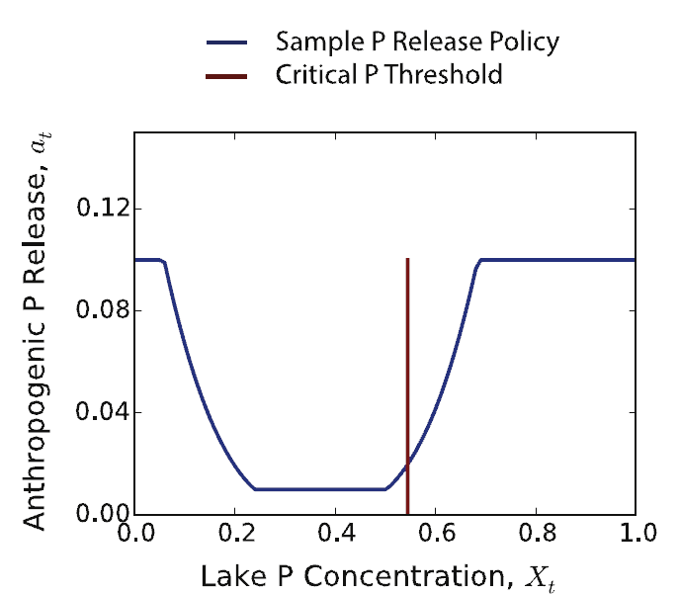
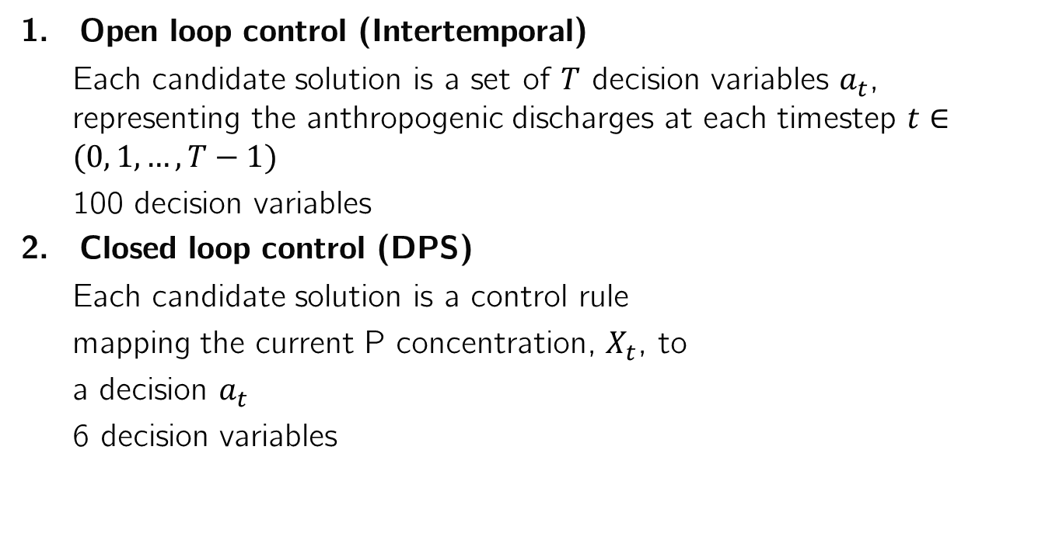
Solution strategies
Open loop control (Intertemporal)
Each candidate solution is a set of $T$ decision variables $a_{t}$, representing the anthropogenic discharges at each timestep $t∈(0, 1, …, T−1)$
100 decision variables
Closed loop control (DPS)
Each candidate solution is a control rule
mapping the current P concentration, $X_{t}$, to
a decision $a_{t}$
6 decision variables
This figure can be replicated by running this script

Slide 20
Model formulation in Rhodium General template for creating a Rhodium model
from rhodium import *
def model_name(array_of_levers, array_of_model_parameters):
return(array_of_model_responses)
model = Model(model_name)
model.parameters = [Parameter(“parameter_name1"),
Parameter(“parameter_name2")]
model.responses = [Response(“system_objective1”, Response.MINIMIZE),
Response(“system_objective2”, Response.MAXIMIZE),
Response(“system_objective3”, Response.INFO)]
model.constraints = [Constraint(" system_objective3 >= 0.8")]
model.levers = [RealLever("array_of_levers", 0.0, 0.1, length=100)]
model.uncertainties = [UniformUncertainty("parameter_name1", 0.0, 5.00),
UniformUncertainty("parameter_name2", 2.0, 8.5)]
output = optimize(model, "NSGAII", 10000)
system model as a function
parameters of interest
model responses or outputs
constraints that must be satisfied
parameters we have control over (levers)
parameters representing exogeneous uncertainties

Slide 21
Model formulation in Rhodium 1. Open loop control (Intertemporal)
import math
import numpy as np
import matplotlib as mpl
import matplotlib.pyplot as plt
from scipy.optimize import brentq as root
from rhodium import *
# Construct the lake problem
def lake_problem(pollution_limit,
b = 0.42, # decay rate for P in lake (0.42 = irreversible)
q = 2.0, # recycling exponent
mean = 0.02, # mean of natural inflows
stdev = 0.001, # standard deviation of natural inflows
alpha = 0.4, # utility from pollution
delta = 0.98, # future utility discount rate
nsamples = 100): # monte carlo sampling of natural inflows
#Body of function
return (max_P, utility, inertia, reliability)
Script can be found here

Slide 22
Model formulation in Rhodium 1. Open loop control (Intertemporal)
model = Model(lake_problem)
model.parameters = [Parameter("pollution_limit"),
Parameter("b"),
Parameter("q"),
Parameter("mean"),
Parameter("stdev"),
Parameter("delta")]
model.responses = [Response("max_P", Response.MINIMIZE),
Response("utility", Response.MAXIMIZE),
Response("inertia", Response.MAXIMIZE),
Response("reliability", Response.MAXIMIZE)]
model.constraints = [Constraint("reliability >= 0.95")]
model.levers = [RealLever("pollution_limit", 0.0, 0.1, length=100)]
model.uncertainties = [UniformUncertainty("b", 0.1, 0.45),
UniformUncertainty("q", 2.0, 4.5),
UniformUncertainty("mean", 0.01, 0.05),
UniformUncertainty("stdev", 0.001, 0.005),
UniformUncertainty("delta", 0.93, 0.99)]
Define all parameters to the model that we will be studying
Define the model outputs
Define any constraints (can reference any parameter or response)
Some parameters are levers that we control via our policy
Some parameters are exogenous uncertainties
Script can be found here

Slide 23
Model formulation in Rhodium 1. Open loop control (Intertemporal)
We can use cache to store intermediate results and also reuse them later without having to rerun the optimization
setup_cache(file="example.cache")
output = cache("output", lambda: optimize(model, "NSGAII", 10000))
Without using the cache, execute with simply:
output = optimize(model, "NSGAII", 25000)
To store outputs:
output.save("output.csv")
To store only objectives:
output.as_dataframe()[list(model.responses.keys())].to_csv('output_objectives.csv')
To load:
output = load('output.csv')[1]
Script can be found here

Slide 24
Model formulation in Rhodium 2. Closed loop control (DPS)
import math
import numpy as np
import matplotlib as mpl
import matplotlib.pyplot as plt
from scipy.optimize import brentq as root
from rhodium import *
# Construct the lake problem
def lake_problem_dps(policy, # the DPS policy
b = 0.42, # decay rate for P in lake (0.42 = irreversible)
q = 2.0, # recycling exponent
mean = 0.02, # mean of natural inflows
stdev = 0.001, # standard deviation of natural inflows
alpha = 0.4, # utility from pollution
delta = 0.98, # future utility discount rate
nsamples = 100, # monte carlo sampling of natural inflows
steps = 100): # the number of time steps (e.g., days)
#Body of function
return (max_P, utility, inertia, reliability)
Script can be found here

Slide 25
Model formulation in Rhodium 2. Closed loop control (DPS)
dps_model = Model(lake_problem_dps)
dps_model.parameters = [Parameter("policy"),
Parameter("b"),
Parameter("q"),
Parameter("mean"),
Parameter("stdev"),
Parameter("delta")]
dps_model.responses = [Response("max_P", Response.MINIMIZE),
Response("utility", Response.MAXIMIZE),
Response("inertia", Response.MAXIMIZE),
Response("reliability", Response.MAXIMIZE)]
dps_model.constraints = [Constraint("reliability >= 0.95")]
dps_model.levers = [CubicDPSLever("policy", length=3)]
dps_model.uncertainties = [UniformUncertainty("b", 0.1, 0.45),
UniformUncertainty("q", 2.0, 4.5),
UniformUncertainty("mean", 0.01, 0.05),
UniformUncertainty("stdev", 0.001, 0.005),
UniformUncertainty("delta", 0.93, 0.99)]
Define all parameters to the model that we will be studying
Define the model outputs
Define any constraints (can reference any parameter or response)
This strategy uses a DPS function as a lever
Some parameters are exogenous uncertainties
Script can be found here

Slide 26
Model formulation in Rhodium 2. Closed loop control (DPS)
We can use cache to store intermediate results and also reuse them later without having to rerun the optimization
setup_cache(file="dps_example.cache")
dps_output = cache("dps_output", lambda: optimize(model, "NSGAII", 10000))
Without using the cache, execute with simply:
dps_output = optimize(model, "NSGAII", 25000)
To store outputs:
dps_output.save("dps_output.csv")
To store only objectives:
dps_output.as_dataframe()[list(dps_model.responses.keys())].to_csv('dps_output_objectives.csv')
To load:
dps_output = load('dps_output.csv')[1]
Script can be found here

Slide 27
Note:
This optimization can also be run with Borg (as was done in the paper).
This is still a beta version functionality of Project Platypus but to do so, download wrappers.py and place it in the platypus repository system files.
Rerun “python setup.py install”.
To run, add this to the top of your code:
from platypus import wrappers
And run with this command instead:
optimize(model, "BorgMOEA", 20000, module="platypus.wrappers", epsilons=[0.01, 0.01, 0.0001, 0.0001])

Slide 28
Exploring tradeoffs with Rhodium
To explore the two sets of candidate strategies using the tools provided by Rhodium, we need to merge them into a single dataset. We can do so by adding a key to each solution identified by each strategy:
for i in range(len(output)):
output[i]['strategy']=1
for i in range(len(dps_output)):
dps_output[i]['strategy']=0
merged = DataSet(output+dps_output)

Slide 29
Exploring tradeoffs with Rhodium
We can visualize the two sets with J3.
We’d need to import it first with: from j3 import J3
J3(merged.as_dataframe(list(model.responses.keys())+['strategy']))

Slide 30
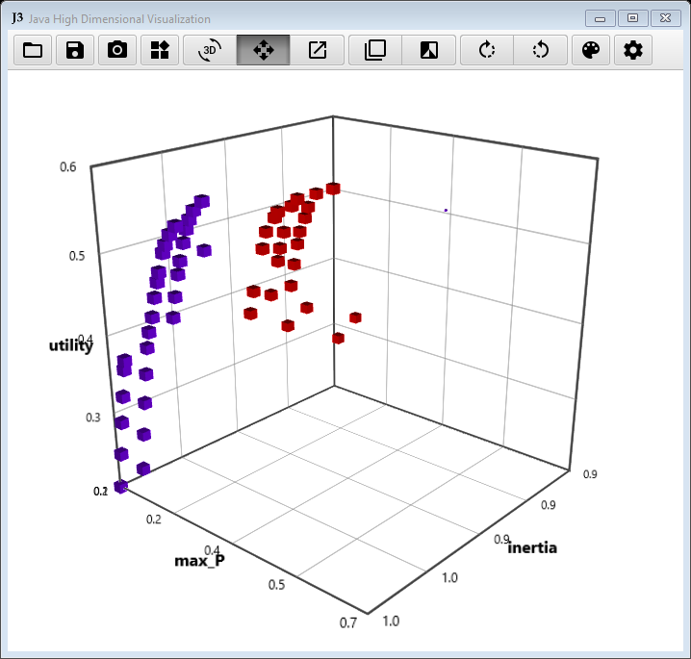
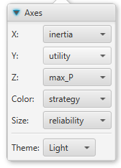
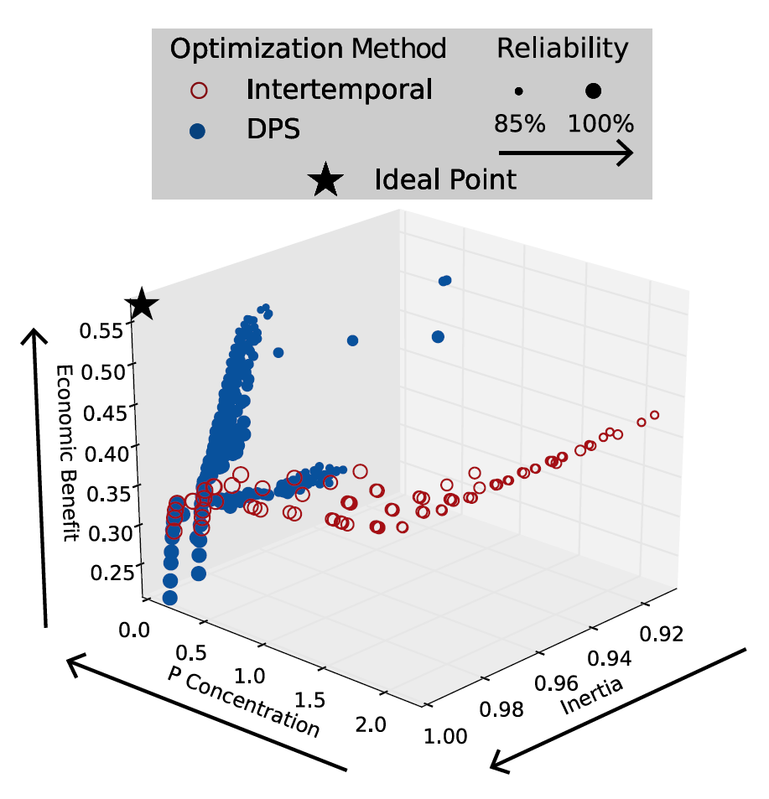
Exploring tradeoffs with Rhodium
Fig. 4
Intertemporal
DPS

Slide 31
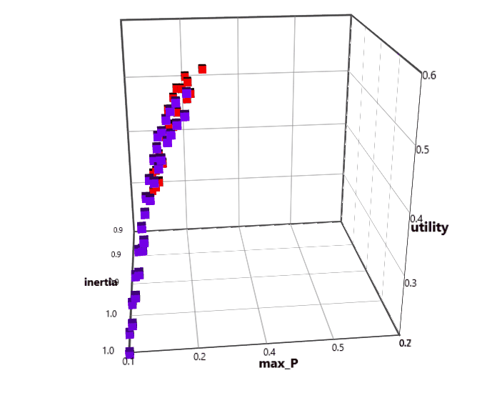
Why is this important?
The results indicate that the DPS strategy was able to find 31 non-dominated solutions whereas the intertemporal strategy found 24 (running Borg for 20000 NFE).
Multiple DPS solutions outperform intertemporal solutions in every objective.
In other words, DPS is able to find solutions that achieve higher economic benefits at lower P concentrations and higher reliability and inertia.

Slide 32
Note:
Doing the analysis in this manner, keeps all solutions found between the two strategies. Some of these solutions might be dominated by solutions found using the other strategy.
We can sort all solutions for non-dominance and generate an overall set of non-dominated solutions.
To do so one can use pareto.py. Save in the same directory and run:
python pareto.py ./*output_objectives.csv -o 1-4 -e 0.01 0.01 0.001 0.001 --header 1 --output overallreference.csv --delimiter="," --comment="#" --contribution --maximize 1 3-4
To load and continue the analysis with this set run:
colnames = ['sol_no']+list(dps_model.responses.keys())+['strategy']
merged_sorted = load('overallreference.csv', names=colnames)[1]

Slide 33
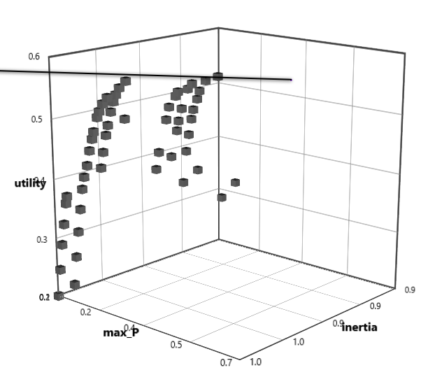
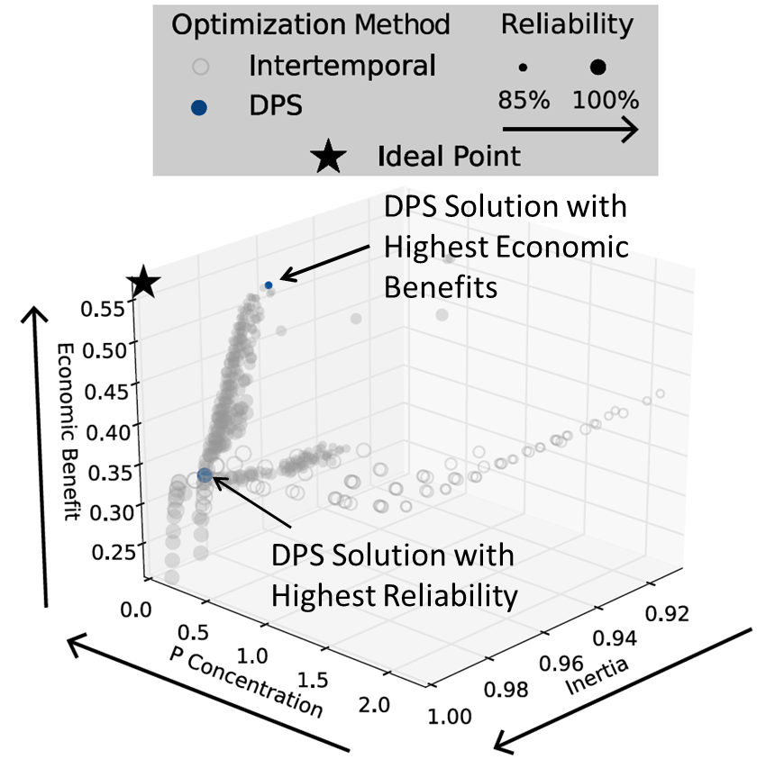
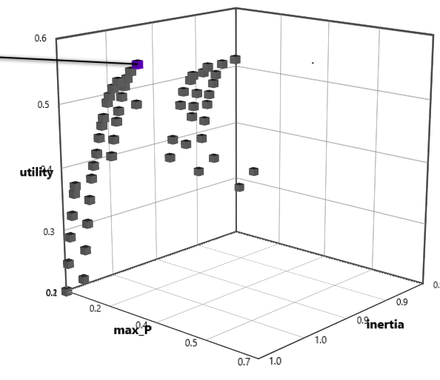
Investigating specific solutions
DPS solution with highest economic benefits
Fig. 4
DPS solution with highest reliability

Slide 34
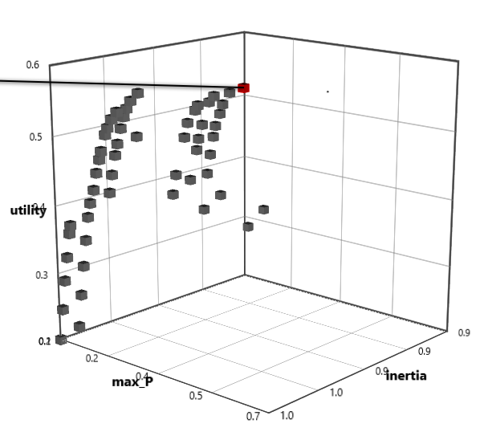
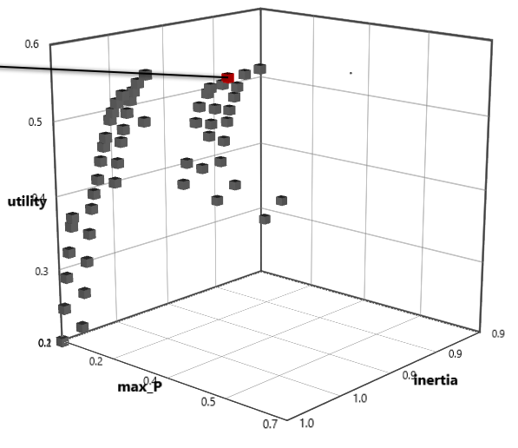
Investigating specific solutions
Intertemporal solution with highest economic benefits
Fig. 4
Intertemporal solution with highest reliability

Slide 35
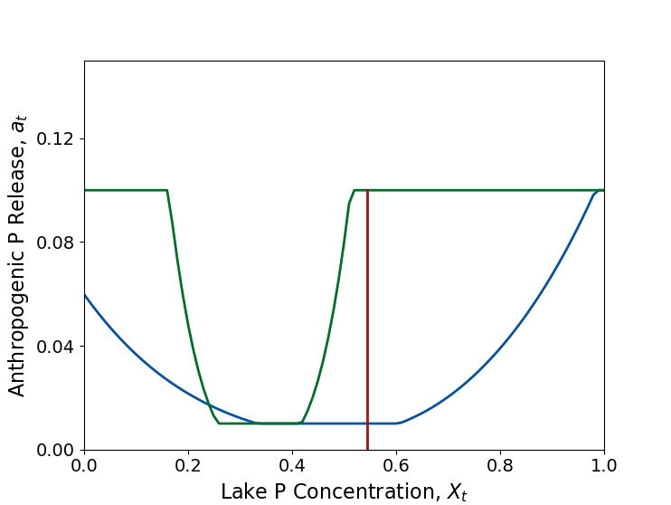
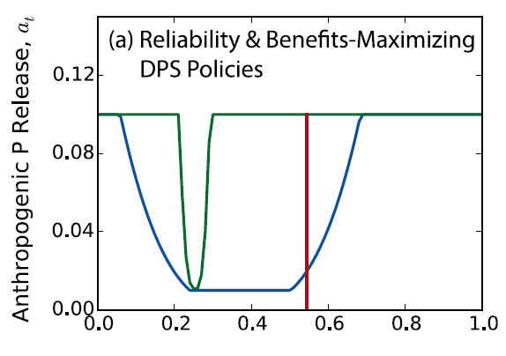
Investigating specific solutions
DPS highest benefits
Critical P threshold
DPS highest reliability
Fig. 6
To generate this figure run this script.

Slide 36
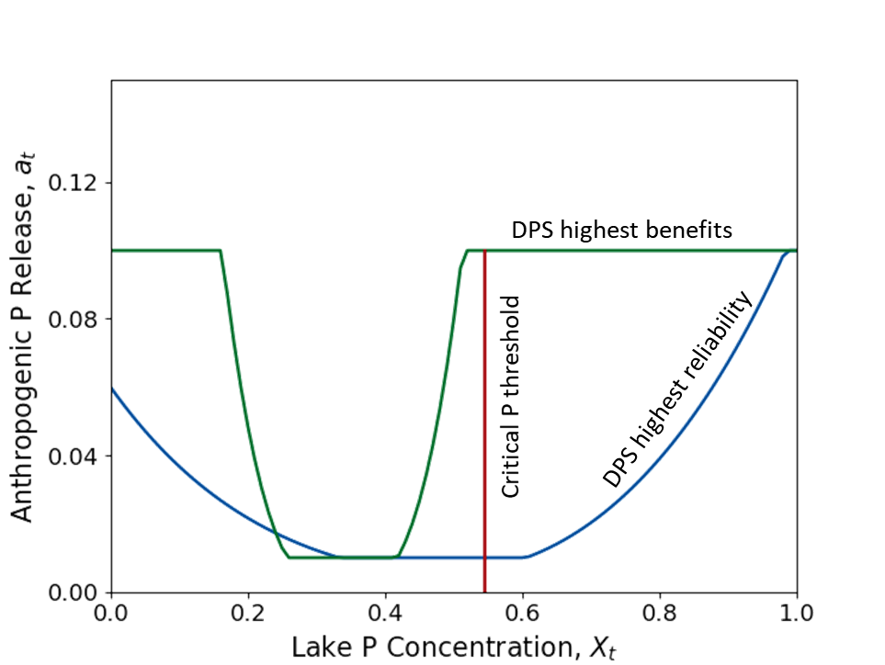
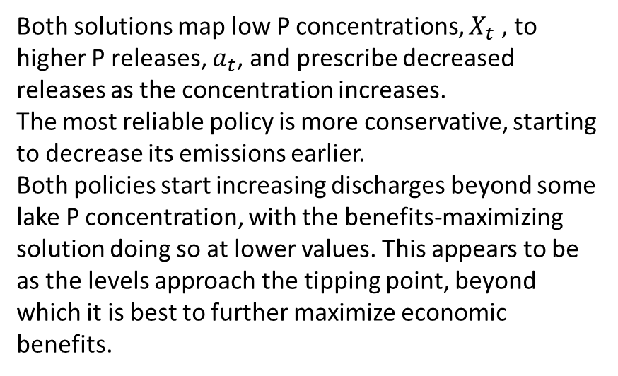
Why is this important?
Policy diagnostics: What makes the identified policies different and how do they affect the system?
This very important step allows us to investigate the candidate policies in more depth and derive insight about the system and how to best manage it.
Both solutions map low P concentrations, $X_{t}$ , to higher P releases, $a_{t}$, and prescribe decreased releases as the concentration increases.
The most reliable policy is more conservative, starting to decrease its emissions earlier.
Both policies start increasing discharges beyond some lake P concentration, with the benefits-maximizing solution doing so at lower values. This appears to be as the levels approach the tipping point, beyond which it is best to further maximize economic benefits.

Slide 37
Robustness Assessment
Evaluated the performance of Intertemporal and DPS solutions on 1,000 Latin hypercube samples of parameter values, or “States of the World” (SOWs):
Parameter | Base Value | Minimum | Maximum
b | 0.42 | 0.1 | 0.45
q | 2 | 2.0 | 4.5
µ | 0.03 | 0.01 | 0.05
σ | √10⁻⁵ ≈ 0.003 | 0.001 | 0.005
X₀ | 0 | 0 | 0.3
δ | 0.98 | 0.93 | 0.99

Slide 38
Robustness Assessment
Evaluated the performance of Intertemporal and DPS solutions on 1,000 Latin hypercube samples of parameter values, or “States of the World” (SOWs):
For each point in the Pareto set, we find the fraction of the 1,000 SOWs in which:
Average Economic Benefits > 0.2 AND Average Reliability > 95%
Parameter | Base Value | Minimum | Maximum
b | 0.42 | 0.1 | 0.45
q | 2 | 2.0 | 4.5
µ | 0.03 | 0.01 | 0.05
σ | √10⁻⁵ ≈ 0.003 | 0.001 | 0.005
X₀ | 0 | 0 | 0.3
δ | 0.98 | 0.93 | 0.99

Slide 39
Assessing robustness with Rhodium
We have already defined our exogenous uncertainties:
model.uncertainties = [UniformUncertainty("b", 0.1, 0.45),
UniformUncertainty("q", 2.0, 4.5),
UniformUncertainty("mean", 0.01, 0.05),
UniformUncertainty("stdev", 0.001, 0.005),
UniformUncertainty("delta", 0.93, 0.99)]
We now need to sample them:
SOWs = sample_lhs(model, 1000)
And reaevalute all identified solutions under all the sampled SOWs:
reevaluation = [evaluate(model, update(SOWs, policy)) for policy in output]
reevaluation_dps = [evaluate(dps_model, update(SOWs, policy)) for policy in dps_output]
This will take a while to run

Slide 40
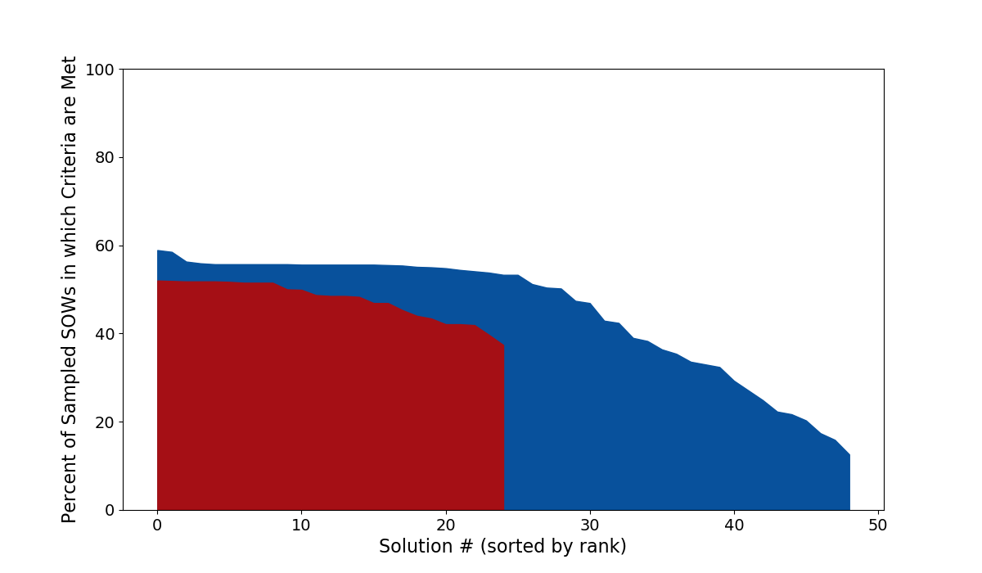
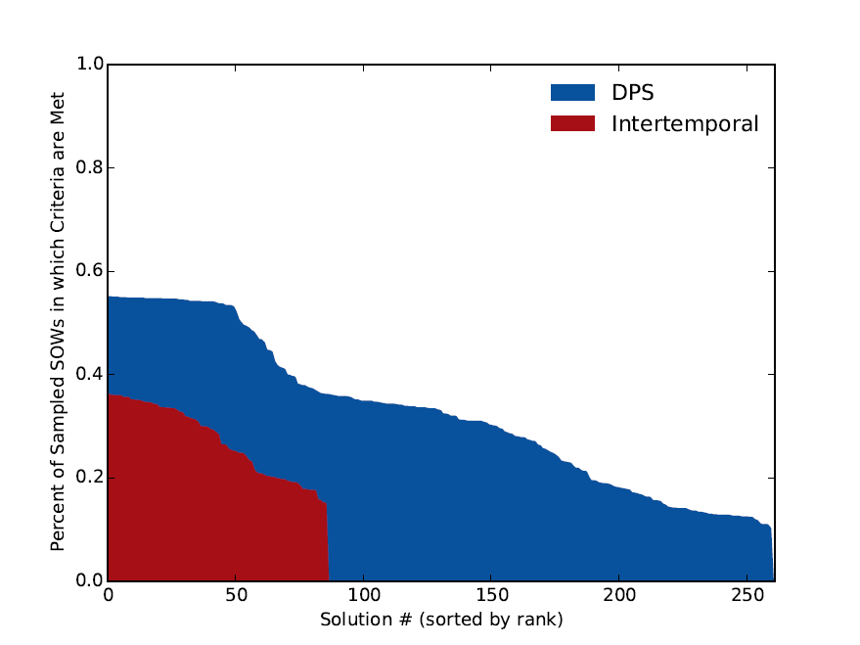
Average Reliability > 95% and Average Economic Benefits > 0.2
Fig. 8

Slide 41
Why is this important?
It appears that are candidate solutions have a hard time meeting these two criteria across the sampled worlds, with the best doing so at less than 60% of the sampled SOWs.
If the sampled parameter combinations are indeed plausible alternative worlds, it is concerning that our options are not robust.
We should like to identify what’s causing these failures and what types of candidate solutions manage to avoid them.

Slide 42
Why is this important?
Mapping solution robustness in the objective space we can see there’s no straightforward relationship between their values and robustness. This would make it difficult to predict a priori the characteristics of solutions likely to be most robust.
Fig. 9
It would also make it impossible to predict in advance what weighted combination of objectives would yield robust solutions.

Slide 43
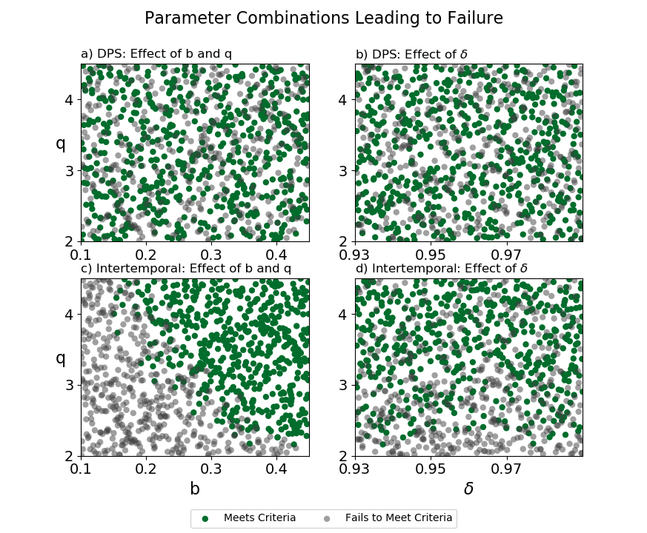
Scenario discovery
Fig. 10

Slide 44
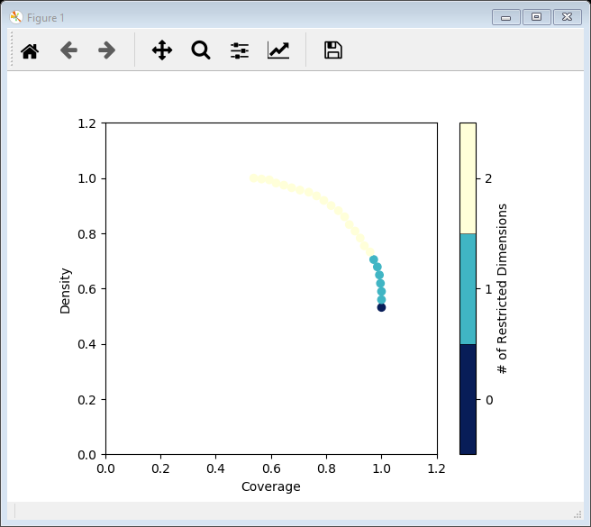
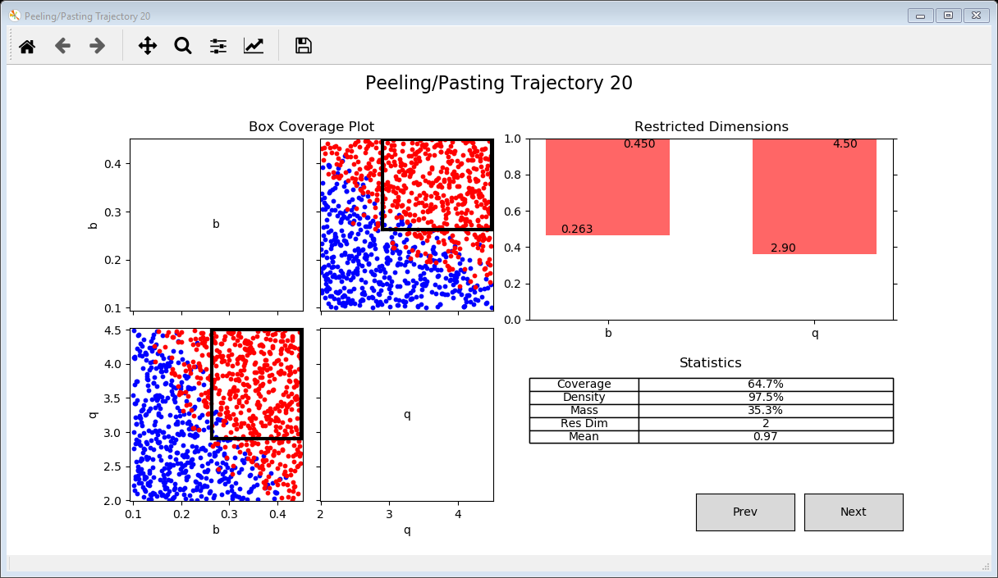
Scenario discovery
Rhodium supports scenario discovery through PRIM and Cart. To run PRIM:
policy = output.find_max("reliability")
scenario_discovery = evaluate(model, update(SOWs, policy))
classification = scenario_discovery.apply("'Reliable' if reliability >= 0.95 and utility >=0.2 else 'Unreliable'")
p = Prim(scenario_discovery, classification, include=model.uncertainties.keys(), coi="Reliable")
box = p.find_box()
fig = box.show_tradeoff()

Slide 45
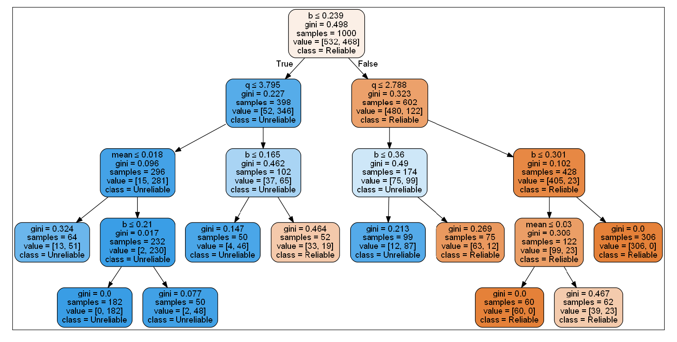
Scenario discovery
Similarly, to run Cart:
c = Cart(scenario_discovery, classification, include=model.uncertainties.keys(), min_samples_leaf=50)
c.show_tree()

Slide 46
Sensitivity analysis of solutions
Rhodium supports several sensitivity analysis methods:
"fast" - Fourier Amplitude Sensitivity Test
"morris" - Method of Morris
"delta" - Borgonovo's Delta Moment-Independent Method
"sobol" - Sobol Sensitivity Analysis
"ff" - Fractional Factorial Sensitivity Analysis
"dgsm" - Derivative-based Global Sensitivity Measure
To run:
policy = output.find_max("reliability")
sobol_results = sa(model, "reliability", policy=policy, method="sobol", nsamples=10000)

Slide 47
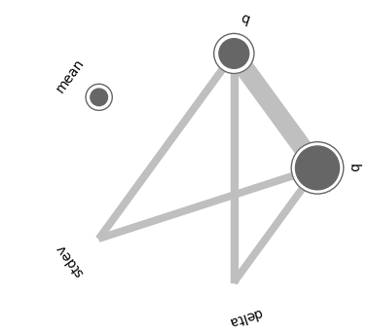
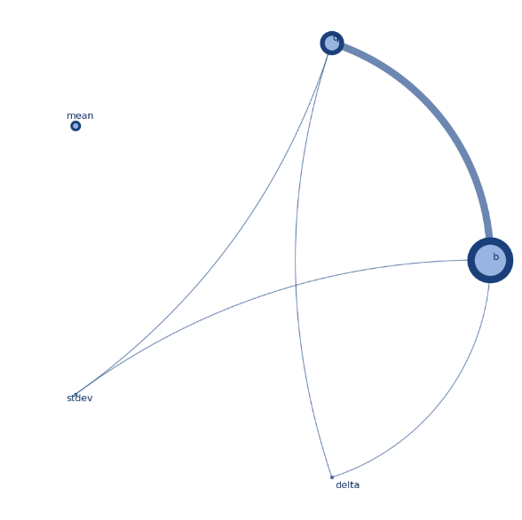
Sensitivity analysis of solutions
Visualize results:
fig = sobol_results.plot_sobol(threshold=0.01)
Or (shameless plug) use my graphing function for prettier and customizable:
drawgraphs(sobol_results)

Slide 48
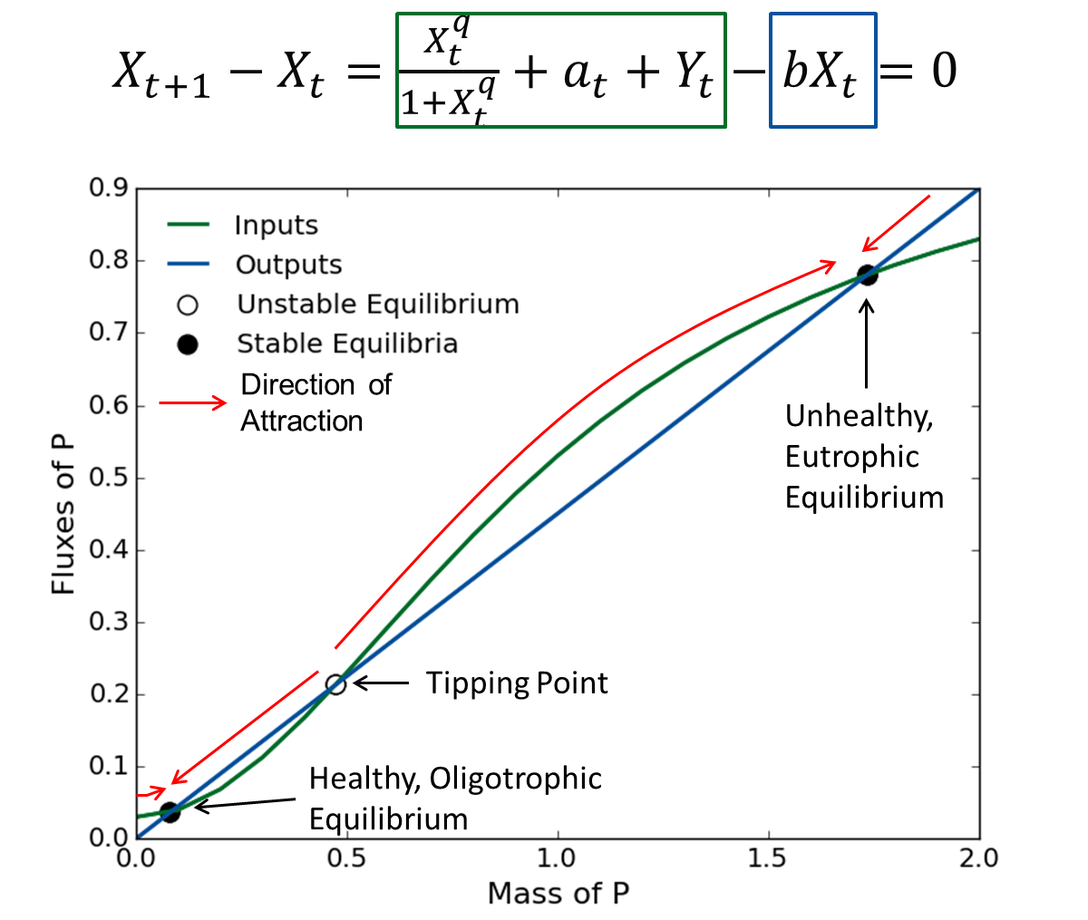
Why is this important?
It appears that there is a non linear combination of b and q values that cause the policy to fail. Both parameters shift the input and output fluxes of P, shifting the tipping point to lower levels.

